Slide 1
BeaMercat
Design&Analysis Presentation

Slide 2
General Presentation
E-commerce website
Variety of products organized by category and provider
Each customer has a shopping cart
Admin type of user that manage user, categories, providers and products

Slide 3
Theory
Iterative approach
Each iteration adds new functionalities
The first = the main iteration, which should make the website operable
The second = add the courier actor
The third = add a review system
And so on…

Slide 4
IT technologies
Spring Boot = the Java Framework used for creating the Web Server
Spring Core
Data access
Model-View-Controller
Transaction Management
Authentication and authorization

Slide 5
MongoDB = persistence
Stores data as BSON documents
JSP = JavaServer Pages used for creating a user interface
Together with HTML and CSS

Slide 6
Functionalities
Each user has an account containing their related details
Login using credentials
Administrator pages used to manage products, users, providers and categories
Customers have shopping carts that keep track of selected products

Slide 7
Actors and related access rights
Customer
Has access to pages regarding their personal details
Can create an account themselves or have one created by an administrator
Administrator
Can be created by other administrator
Has access to all pages

Slide 8
Use Cases

Slide 9
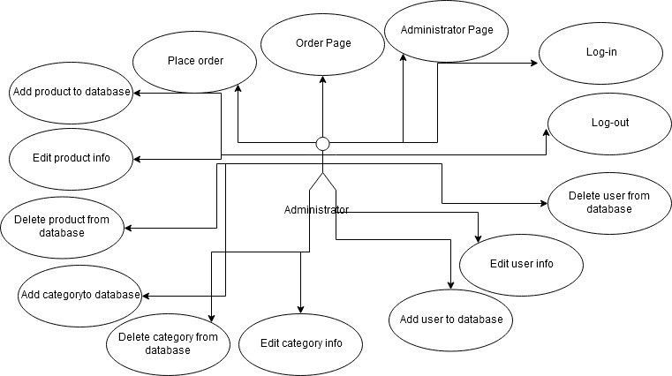

Slide 10
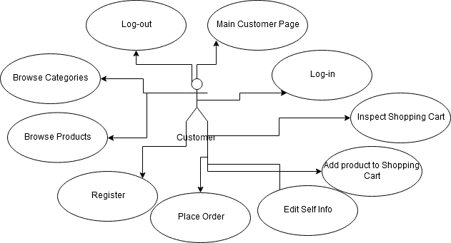

Slide 11
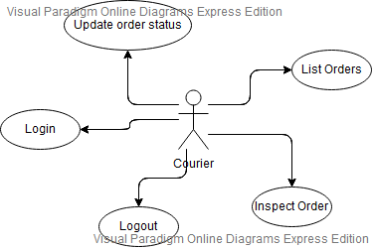

Slide 12
System Architecture

Slide 13
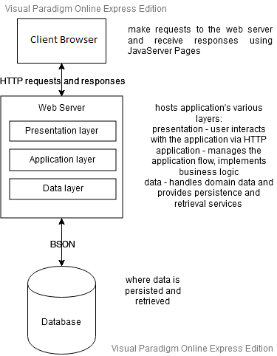

Slide 14
Design

Slide 15
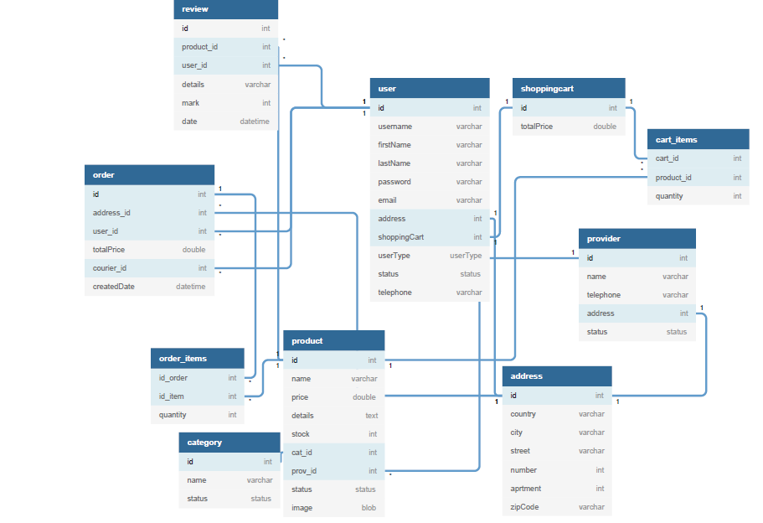
Database Diagram

Slide 16
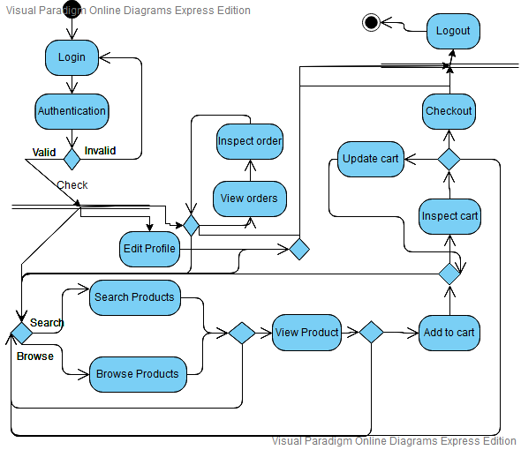
Activity Diagram

Slide 17
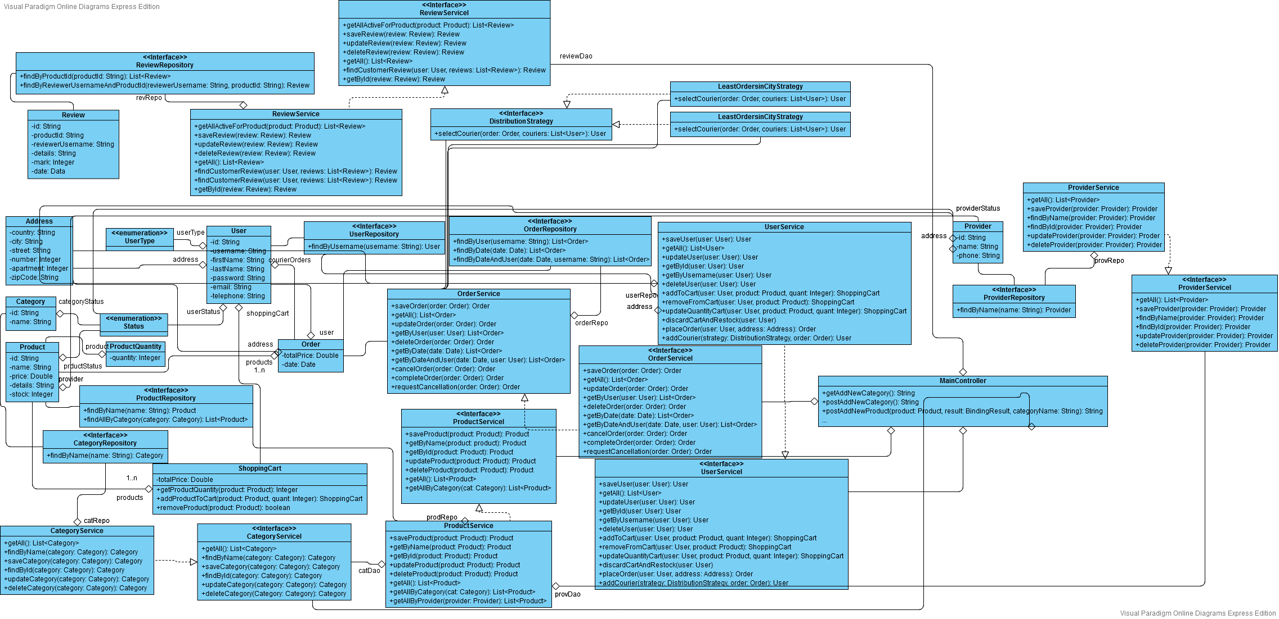
Class Diagram

Slide 18
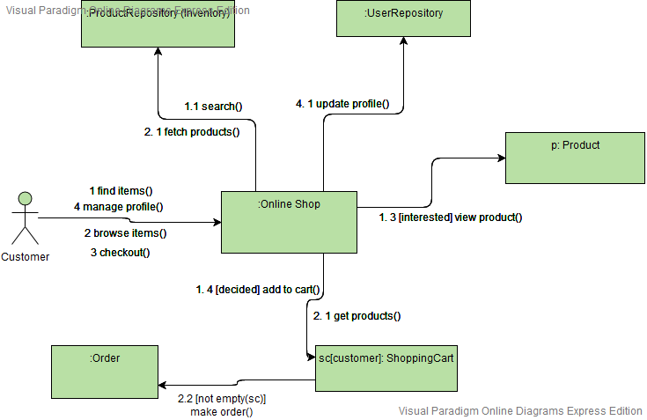
Communication Diagram

Slide 19
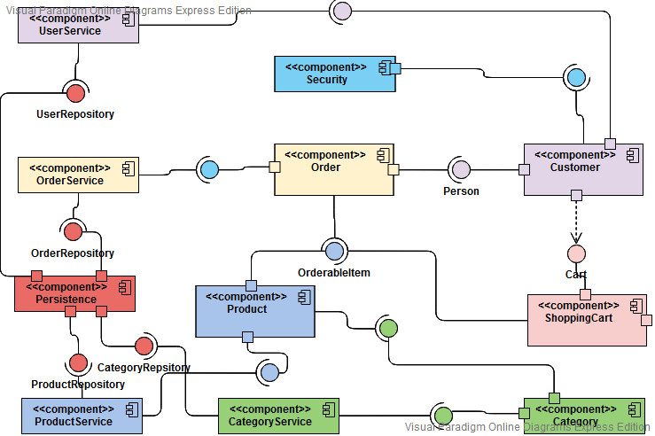
Component Diagram

Slide 20
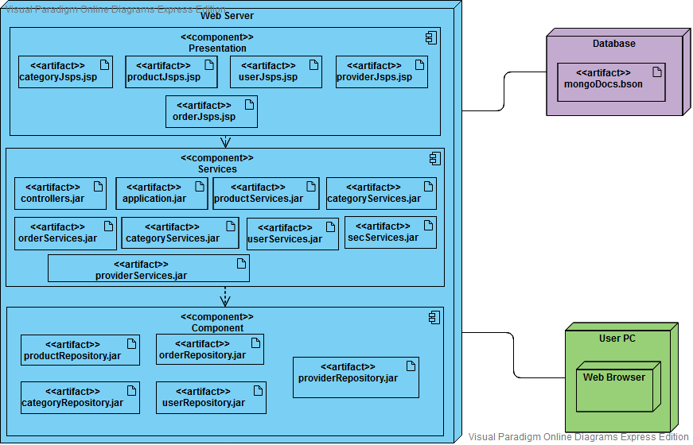
Deployment Diagram

Slide 21
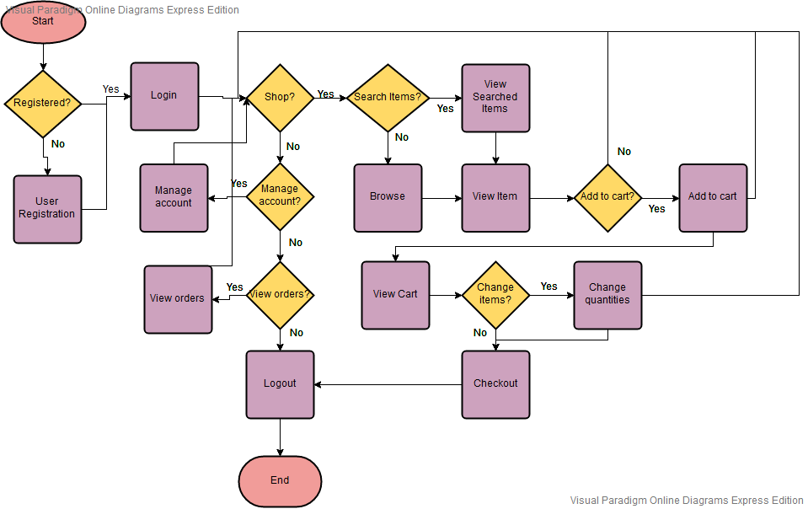
FlowChart

Slide 22
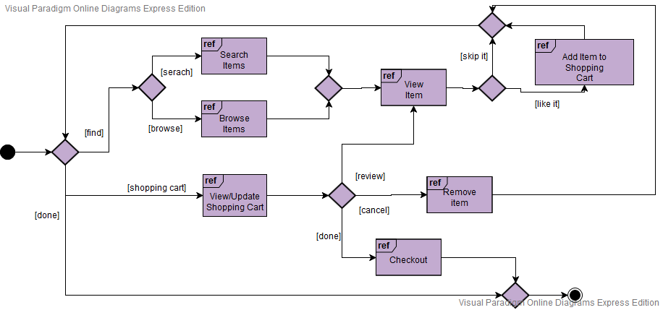
Interaction Diagram

Slide 23
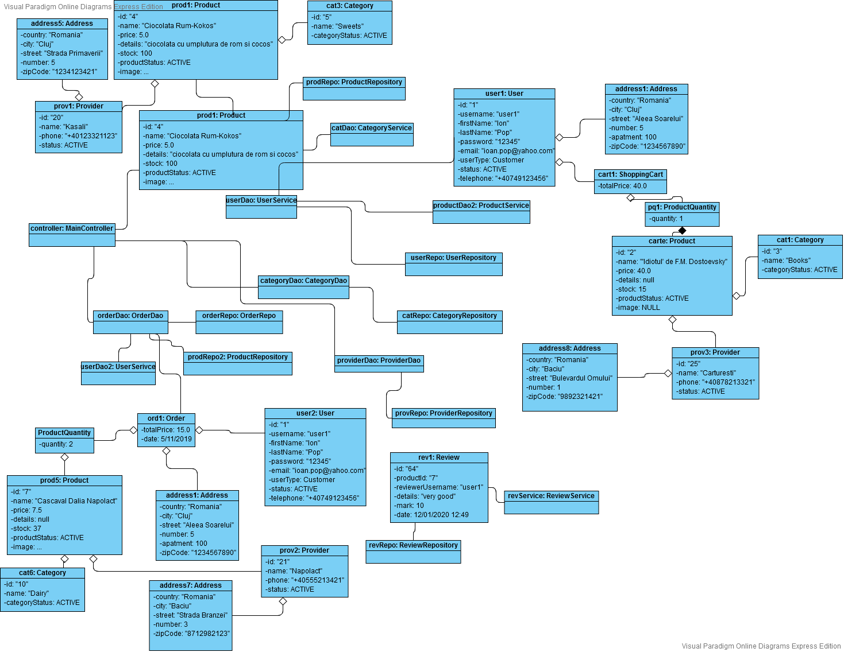
Object Diagram

Slide 24
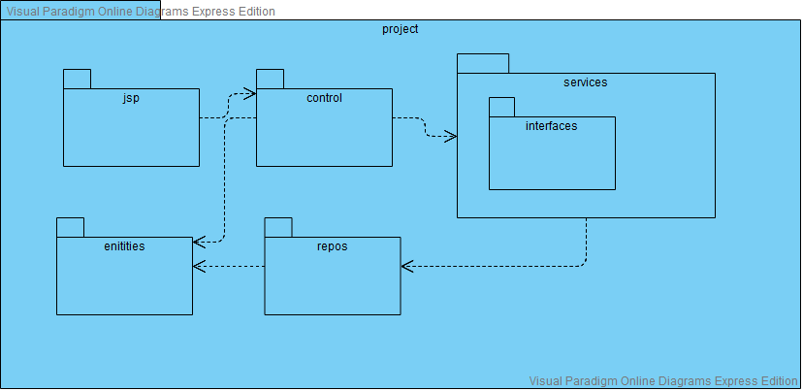
Package Diagram

Slide 25
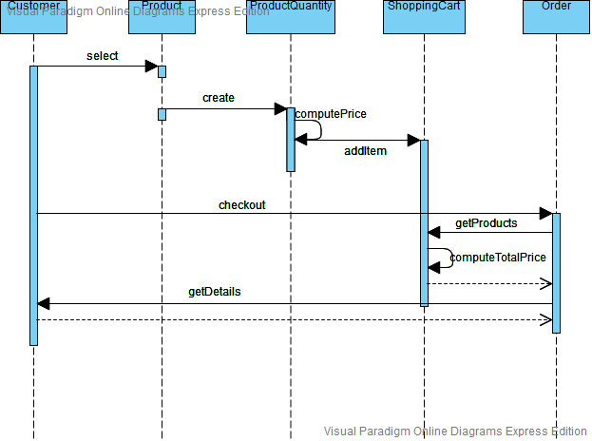
Sequence Diagram

Slide 26
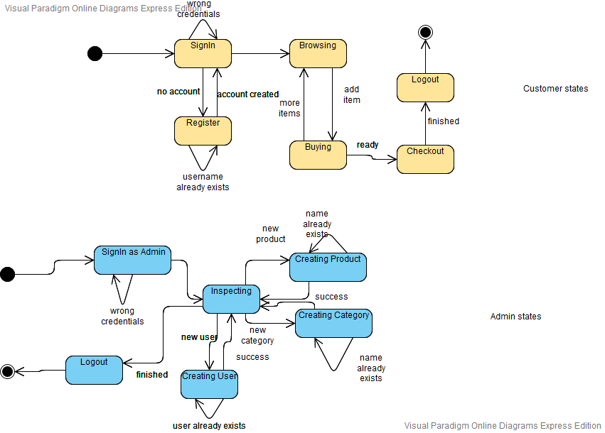
State Diagram

Slide 27
Operation Mode

Slide 28
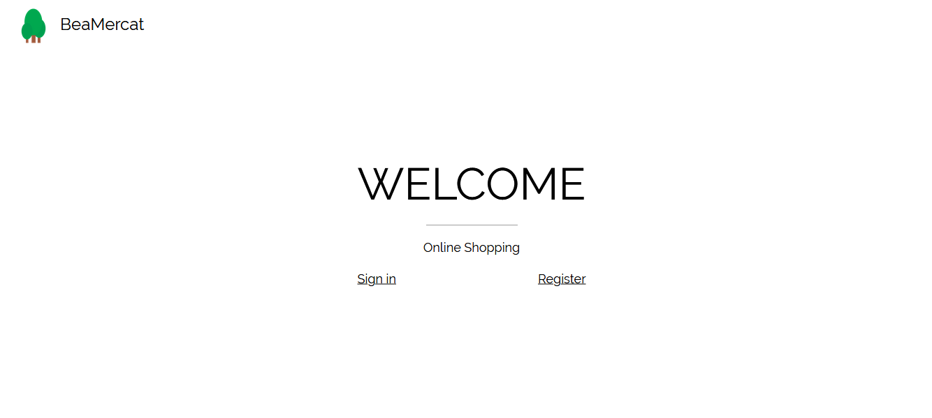
Welcome

Slide 29
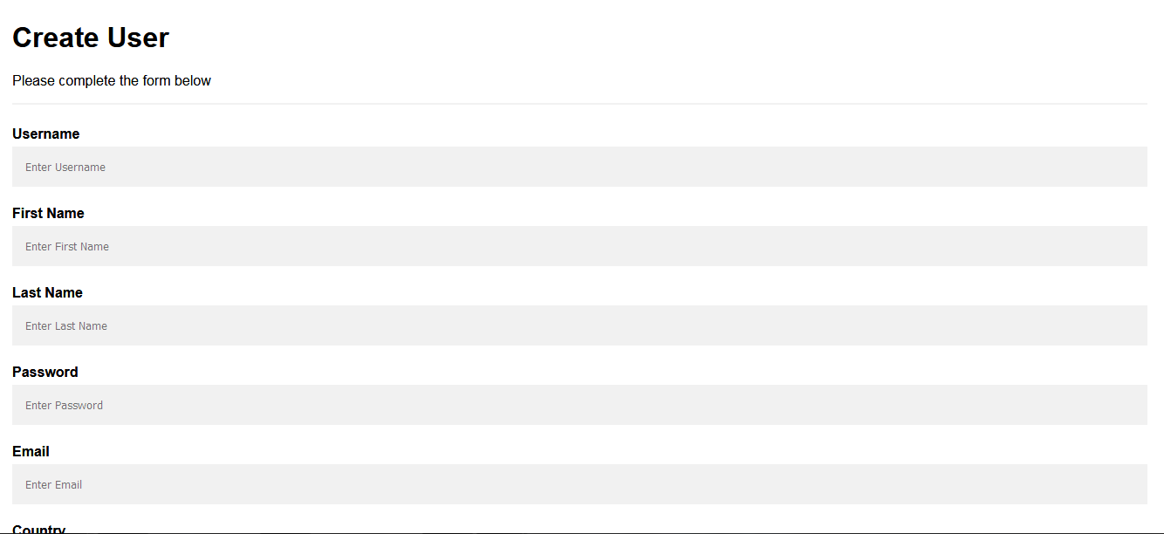
Create User

Slide 30
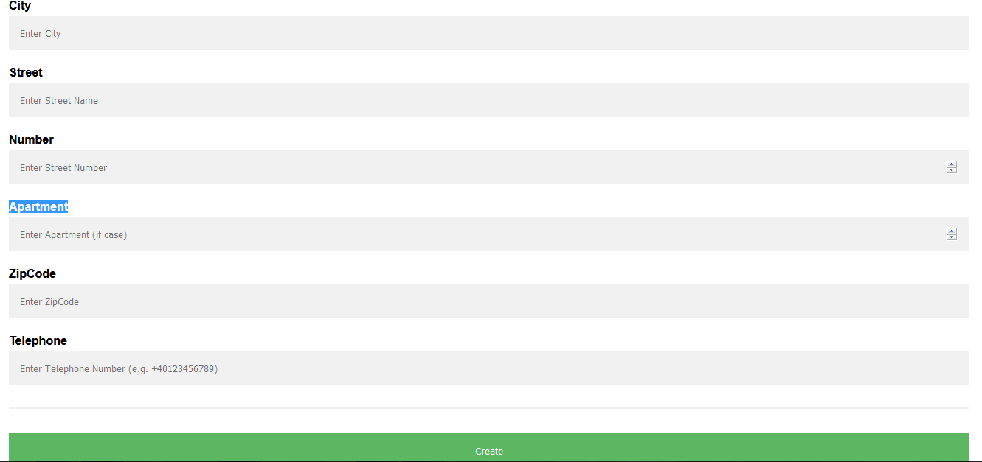

Slide 31
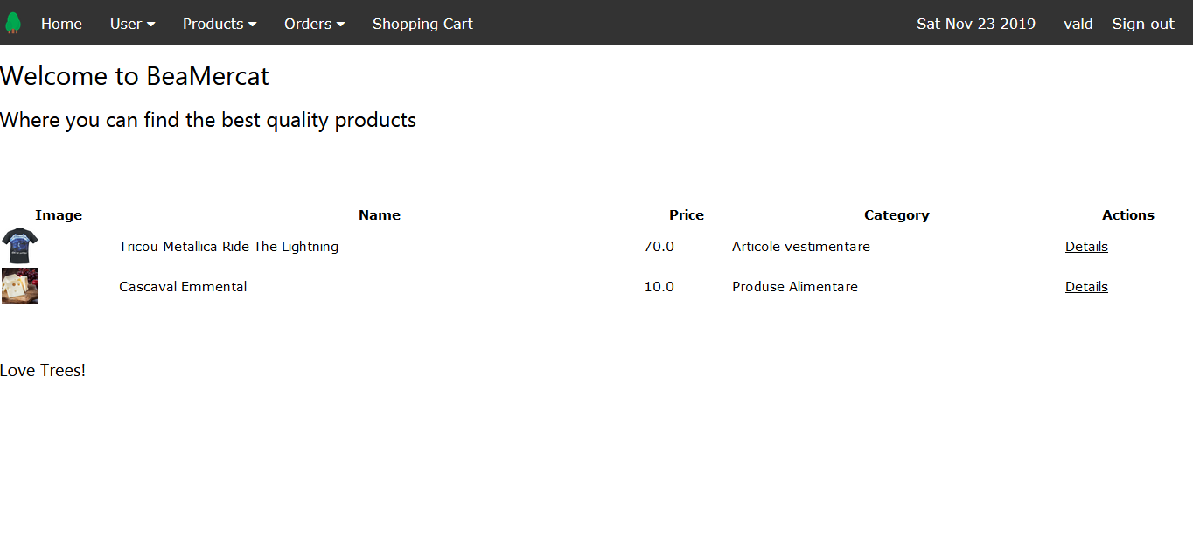
Main Page

Slide 32
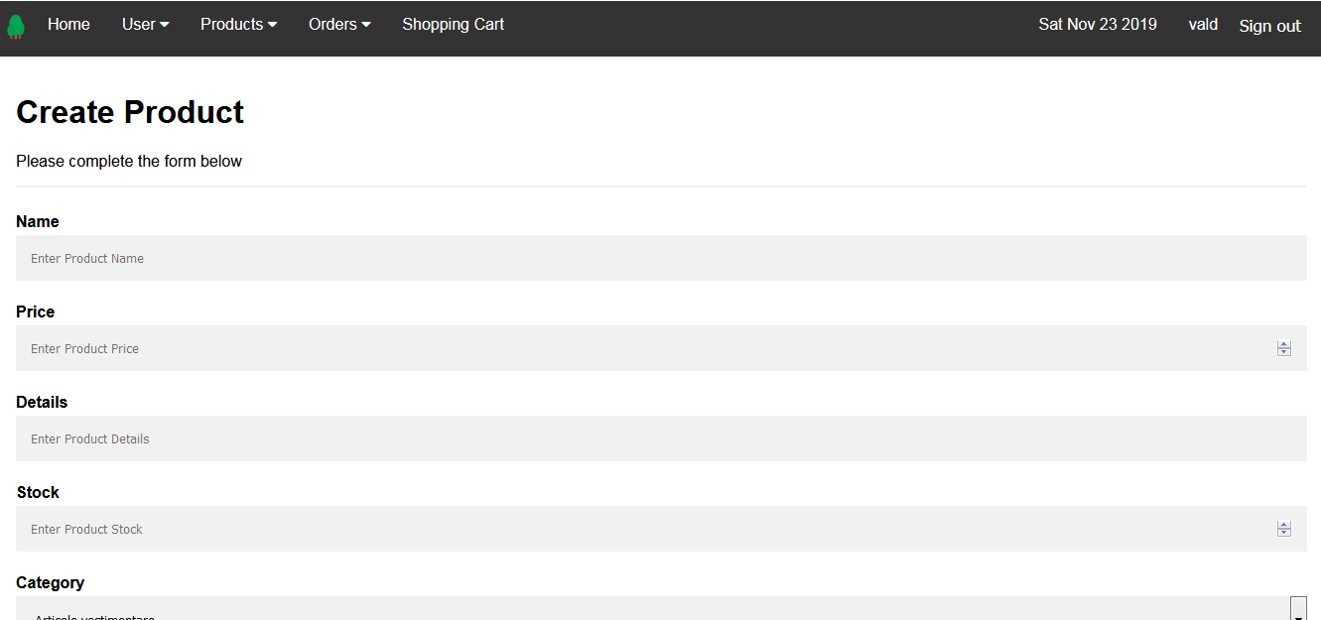
Create Product

Slide 33
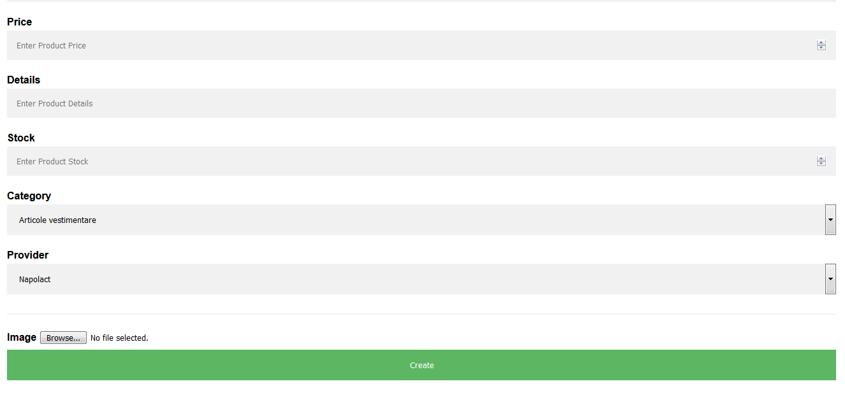

Slide 34
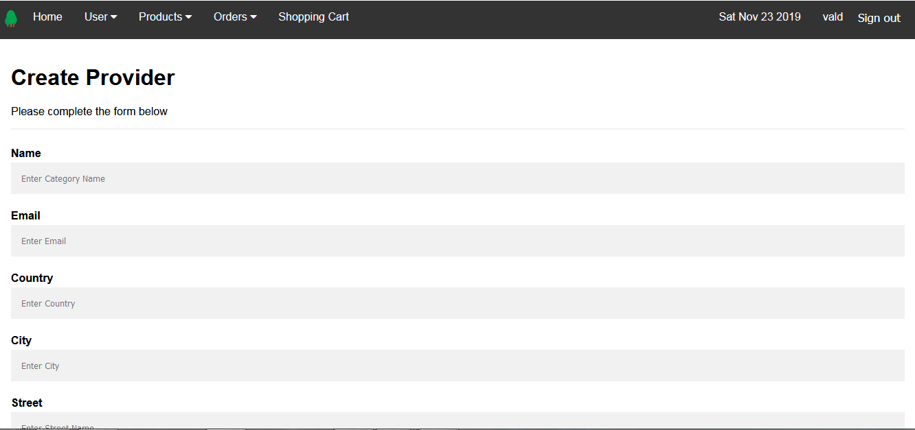
Create Provider

Slide 35
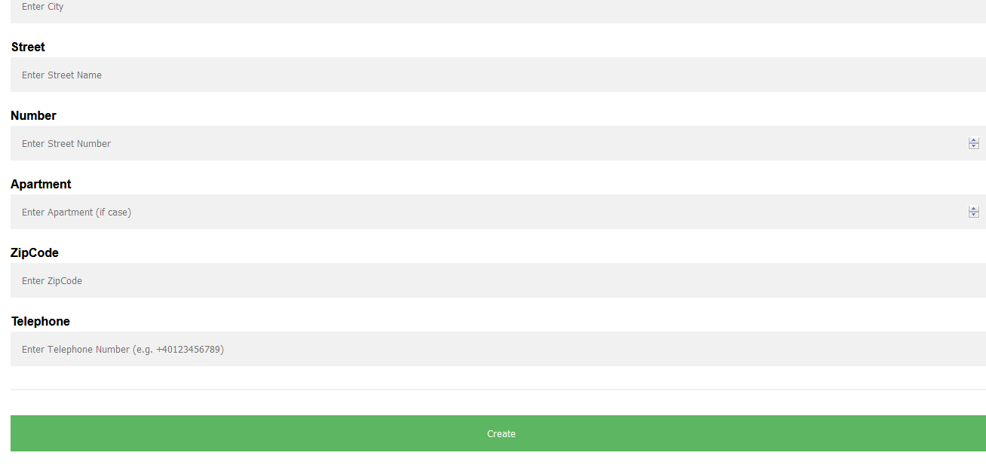

Slide 36
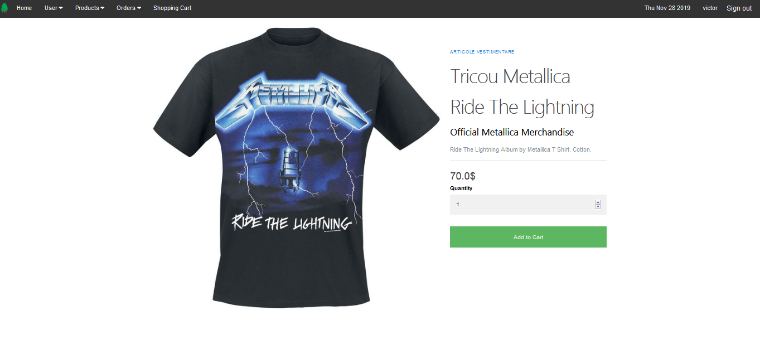
Product Page

Slide 37
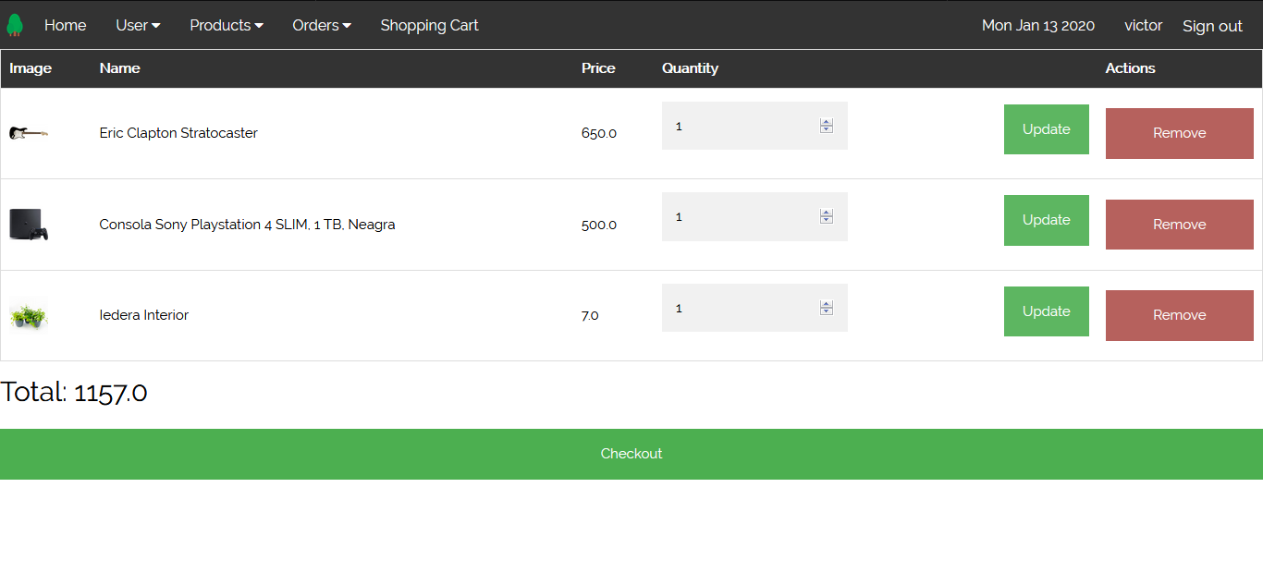
Shopping Cart

Slide 38
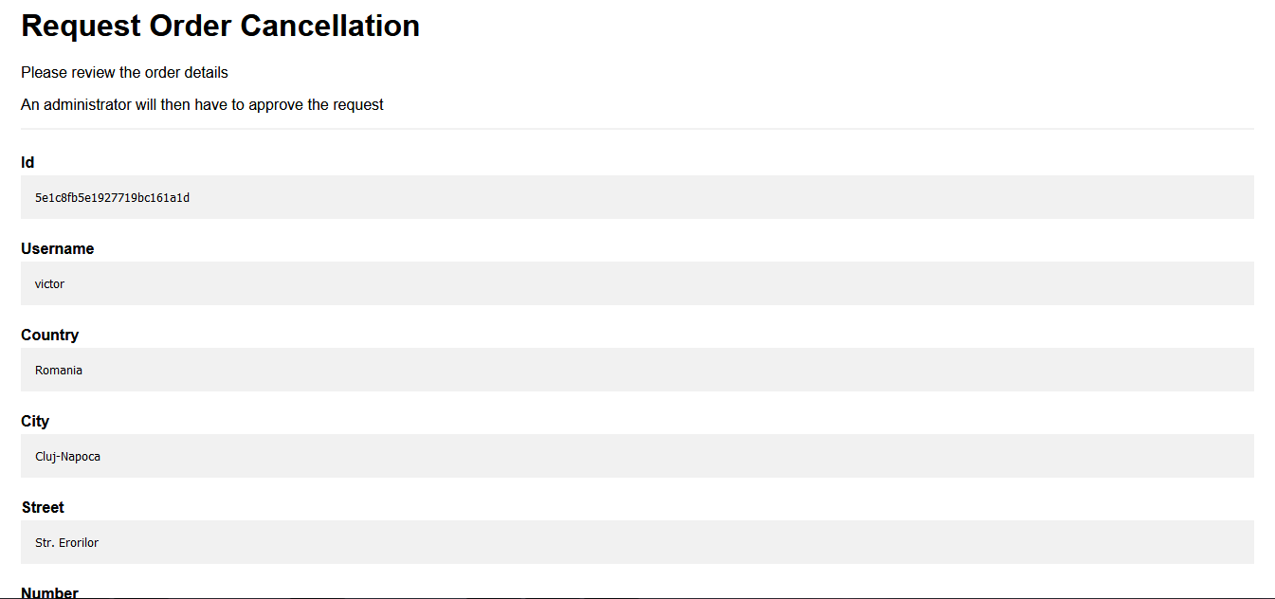
Cancel Order

Slide 39
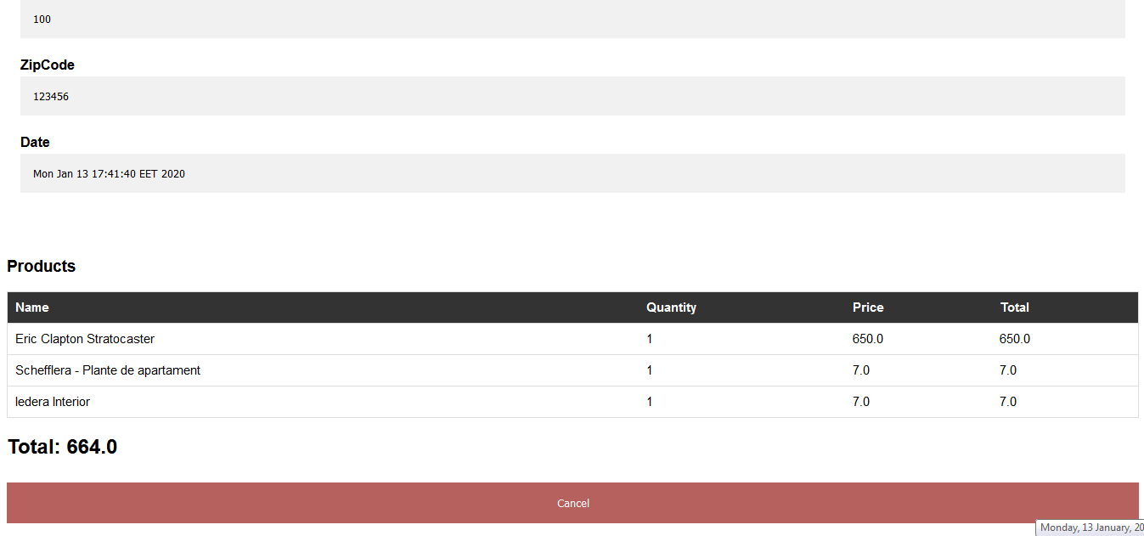

Slide 40
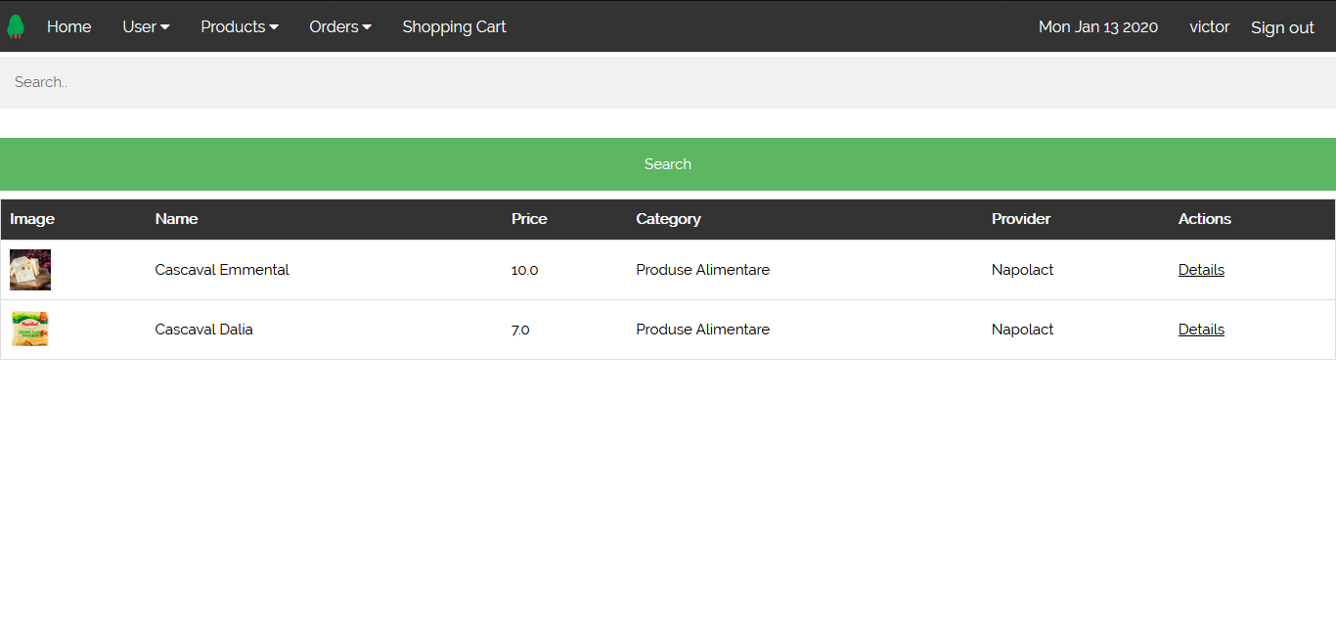
Search Product

Slide 41
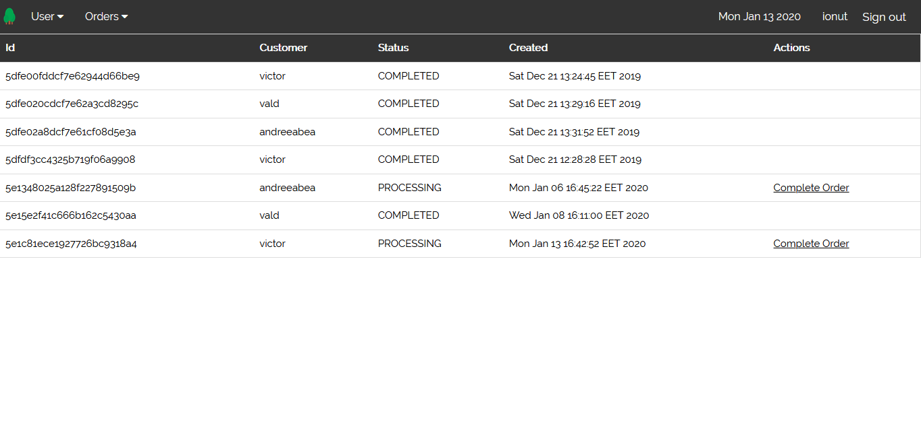
Courier Orders

Slide 42
Test Cases
Register
Login
Browse products and add product to shopping cart
Search Product
Update Shopping Cart Quantity
Search by Category
Search by Provider
Checkout
Checkout Custom Address

Slide 43
Update User Details – Customer
Create Customer – Admin
Create Provider
Create Category
Create Product
Delete Product
Update Provider
Complete Order

Slide 44
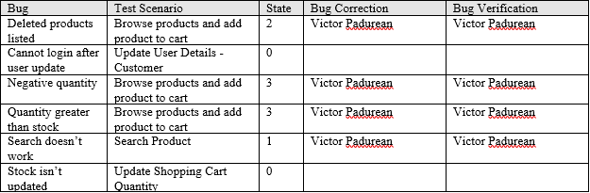

Slide 45
Portability
Needs JDK, JRE, Maven and MongoDB
If built JAR file, needed only JRE and MongoDB
Could be dokerized

Slide 46
Competing Software
Amazon
emag
eBay
Alibaba
olx

